Slide 1

Muhammad Atif Saeed (Lecturer DS & AI)

Slide 2
Evaluation Metrics in Machine Learning
When building machine learning models, it’s important to understand how well they perform.
Evaluation metrics help us to measure the effectiveness of our models.
Whether we are solving a classification problem, predicting continuous values or clustering data, selecting the right evaluation metric allows us to assess how well the model meets our goals.

Slide 3
Confusion Matrix
Confusion matrix creates a N X N matrix, where N is the number of classes or categories that are to be predicted.
Here we have N = 2, so we get a 2 X 2 matrix. Suppose there is a problem with our practice which is a binary classification.
Samples of that classification belong to either Yes or No. So, we build our classifier which will predict the class for the new input sample.
After that, we tested our model with 165 samples and we get the following result.
n=165 | Predicted Yes | Predicted No
Actual Yes | 100 | 5
Actual No | 10 | 50
There are 4 terms we should keep in mind:
True Positives: It is the case where we predicted Yes and the real output was also Yes.
True Negatives: It is the case where we predicted No and the real output was also No.
False Positives: It is the case where we predicted Yes but it was actually No.
False Negatives: It is the case where we predicted No but it was actually Yes.

Slide 4

Accuracy
Accuracy is a fundamental metric used for evaluating the performance of a classification model. It tells us the proportion of correct predictions made by the model out of all predictions.
While accuracy provides a quick snapshot, it can be misleading in cases of imbalanced datasets. For example, in a dataset with 90% class A and 10% class B, a model predicting only class A will still achieve 90% accuracy but it will fail to identify any class B instances.

Slide 5
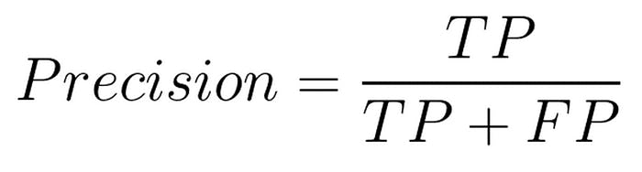
Precision
It measures how many of the positive predictions made by the model are actually correct. It's useful when the cost of false positives is high such as in medical diagnoses where predicting a disease when it’s not present can have serious consequences.

Slide 6
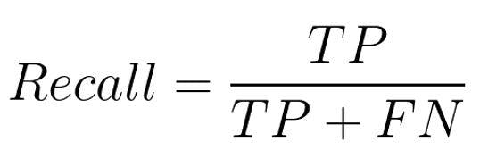
Recall
Recall or Sensitivity measures how many of the actual positive cases were correctly identified by the model. It is important when missing a positive case (false negative) is more costly than false positives.

Slide 7
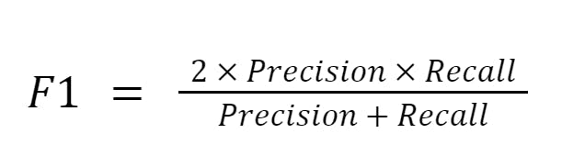
F1 Score
The F1 Score is the harmonic mean of precision and recall. It is useful when we need a balance between precision and recall as it combines both into a single number. A high F1 score means the model performs well on both metrics. Its range is [0,1].

Slide 8
Clustering Metrics
In unsupervised learning tasks such as clustering, the goal is to group similar data points together.
Evaluating clustering performance is often more challenging than supervised learning since there is no explicit ground truth.
However, clustering metrics provide a way to measure how well the model is grouping similar data points.

Slide 9
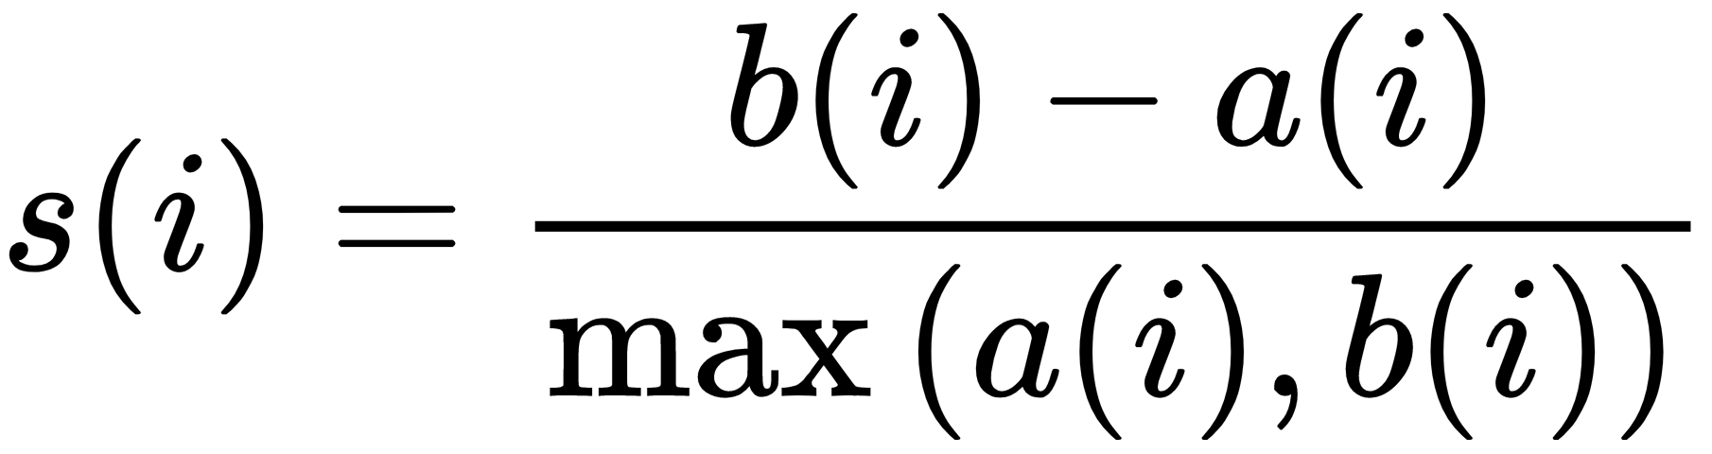
Silhouette Score
Silhouette Score evaluates how well a data point fits within its assigned cluster considering how close it is to points in its own cluster (cohesion) and how far it is from points in other clusters (separation).
A higher silhouette score (close to +1) shows well-clustered data while a score near -1 suggests that the data point is in the wrong cluster.
a = Average distance between a sample and all other points in the same cluster
b = Average distance between a sample and all points in the nearest cluster

Slide 10

Davies-Bouldin Index
Davies-Bouldin Index measures the average similarity between each cluster and its most similar cluster.
A lower Davies-Bouldin index shows better clustering as it suggests the clusters are well-separated and compact. The goal is to minimize the Davies-Bouldin index to achieve optimal clustering.
σ i= Average distance of points in cluster i from the cluster centroid
d(ci​,cj) = Distance between centroids of clusters i and j

Slide 11
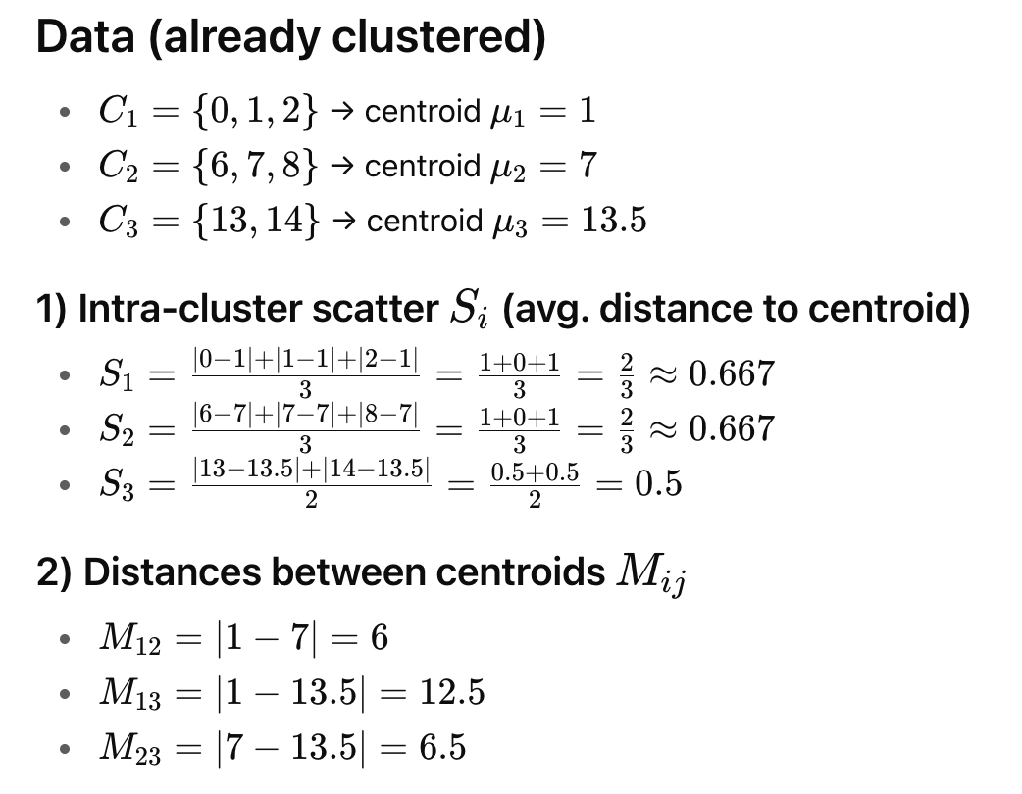
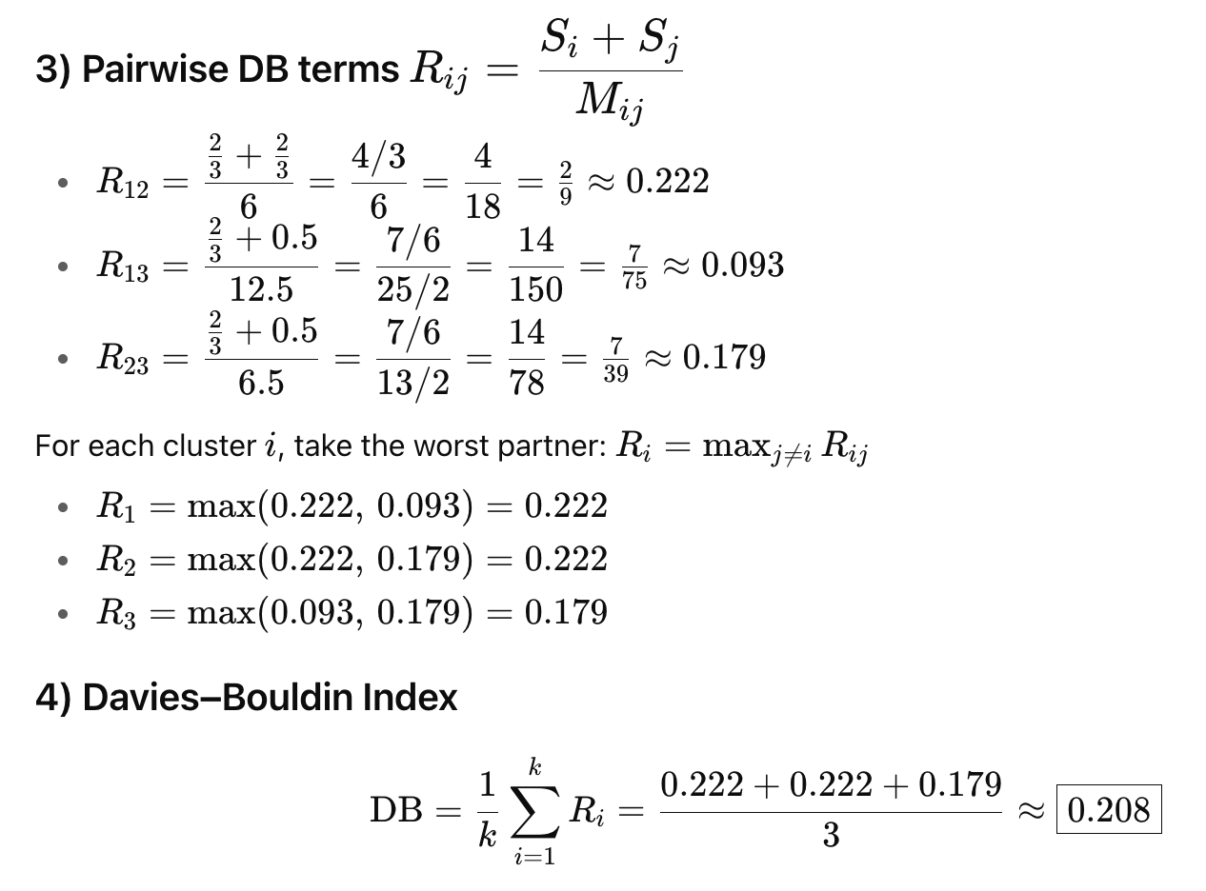
Davies-Bouldin Index

